Slide 1
ICT Spreadsheets Lesson 1: Introduction to Spreadsheets

Slide 2
Objectives – Lesson 1
8.1.1: Define "spreadsheet" and describe ways it may be used.
8.1.2: Identify the parts of the spreadsheet display, including cells, columns and rows, cell references, cell range.
8.1.3: Create and navigate through multiple spreadsheets in a file.
8.1.4: Insert and format text information in spreadsheet cells.
8.1.5: Insert and format numeric information in spreadsheet cells.
8.1.6: Insert and format date and time information in spreadsheet cells.
8.1.7: Select multiple cells, including adjacent and non-adjacent ranges, using mouse and keyboard techniques.
8.1.8: Copy and/or move information from one or more cells to another part of the spreadsheet.
8.1.9: Use the Undo and Redo tools in a spreadsheet.
8.1.10: Apply and modify cell formatting for currency, date and percentage values.
8.1.11: Use the Sort function to organize information numerically or alphabetically, including multiple levels of sorting.
8.1.12: Use the Filter function to display spreadsheet data based on specific criteria.
8.1.13: Resize column width and row height in a spreadsheet.
8.1.14: Insert and delete columns and rows in a spreadsheet.
8.1.15: Merge and unmerge cells in a spreadsheet.
8.1.16: Apply shading and borders to a spreadsheet.

Slide 3
Spreadsheet Basics
A spreadsheet has multiple columns and rows which can hold financial information and store records of data like test scores, contact information, and much more.
Spreadsheets:
Help managers make informed decisions
Are made up of columns – each identified with a letter (A, B, C, etc.) and numbered rows.
The intersection of a row and column is a cell
Each cell is defined by a cell reference or more simply, its column and row – like C7 or J15.
A group of selected cells (A1:D10) is better defined as a cell range

Slide 4
Google Sheets
Enables real-time collaboration. If more than one person has the same file open, each collaborator will appear with a letter or image circle to the left of the Comments button in the top right-corner of the window.
Once you assign a title to your spreadsheet, it will automatically save your changes every few minutes which is why no Save command appears in the File menu.
Default Title, unless changed
Shortcut Toolbar Menu
Toolbar Menu
This is the formula bar (A1+D10)

Slide 5
Excel Spreadsheet
Saving frequently will help to avoid loss of work if there is a loss of power, computer failure or your spreadsheet closes unexpectedly.
Once you have named your file and completed the initial save, you can quickly save changes to your file using the Save button in the Quick Access Toolbar
Quick Access Toolbar
Spreadsheet Title
Ribbon
This is the formula bar (A1+D10)

Slide 6
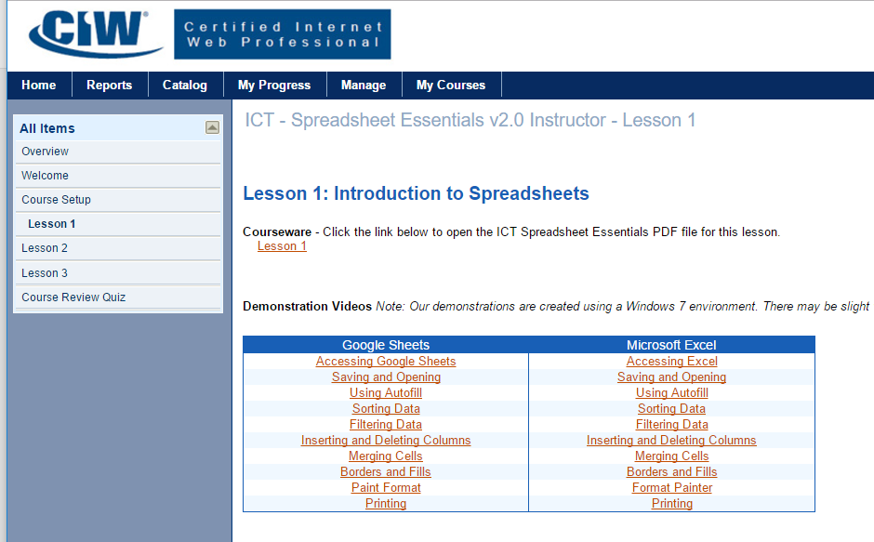
Let’s Watch the Video
How to Access, Open, and Save Spreadsheets
Click Here
Notes:
Discuss types of connections – “Connecting to the Internet” video

Slide 7
Entering Data into a Spreadsheet
Text (words) automatically defaults to align to the left side of the cell.
Numbers automatically defaults to align to the right side of the cell.
You can also format cells any style you prefer by clicking on the open dialog box or the drop down menu in the number section of the home tab.
Drop down menu
Open Dialog box

Slide 8
Selecting Data
Using your mouse, you can click a single cell to select it or click and drag your pointer across a range of cells to select multiple cells.
Or you can use these common keyboard shortcuts to select cells:
Select All Cells = +
Selects each cell as you move through = +
Selects a group of cells =
+ +
A
Shift
Shift

Slide 9
Undo and Redo Commands
Undo command - quickly back out the change and restore your spreadsheet to its original format
Redo command - restores whatever was undone.
+
Z
+
Y

Slide 10
Cut, Copy and Paste Commands
Cut command - removes the selected cell(s) from their current location
Paste command - insert the cells into new position in the spreadsheet
Copy command - takes a picture of the selected cell(s) and uses the Paste command to insert a “copy” of the cells in other locations
When you cut or copy text or an object, it is placed in a temporary storage space called a Clipboard
+
X
+
V
+
C

Slide 11
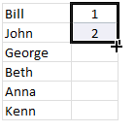
Copy using Autofill
Autofill handle– the square that appears on the bottom right corner of a cell when you click on it.
Using the drag-and-drop motion to copy cell content the Autofill can:
Copy the contents of a cell.
Populate cells with a pre-defined series of content.
Populate cells with a sequential series of content based on your entries.

Slide 12
Let’s Watch the Video
How to use Autofill
Click Here
Notes:
Discuss types of connections – “Connecting to the Internet” video

Slide 13
Formatting Numbers, Text, & Dates
You can align your text vertically and horizontally with the alignment buttons
You can quickly change how a number (quantity, currency, fractions/ decimals or percent, date and time) appears using this drop-down menu
Dates can also have different formats and often, time can be included with a date for more accurate data recording

Slide 14
Sorting and Filtering Spreadsheet Data
Sorting helps with re-organizing the data in your records by a field or category (column).
For example: Reordering your participants by last name would place all the names in alphabetical (ascending) order, making it easier to find a participant’s name any event.
Filtering helps with locating your record(s) based upon specific criteria you select for one or more fields or columns of data.
When a filter is applied, records that do not meet the criteria specified in the filter are hidden from view.

Slide 15
Let’s Watch the Video
How to Filter and Sort Data
Click Here
Notes:
Discuss types of connections – “Connecting to the Internet” video

Slide 16
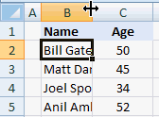
Formatting Cells, Columns, and Rows
Excel is primarily used for data not sentences.
Entering several words into a single cell causes the text to display across several cells even though all the text is entered into only one cell
You can format data by:
Automatically adjusting the column width to “fit” the content by double-clicking when the double-arrow pointer appears. Same with the row height.
Wrap Text Button – wrap your content within the existing boundaries of column width and increase the row height.

Slide 17
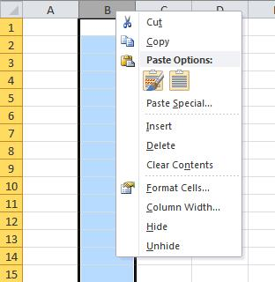
Inserting and Deleting Rows and Columns
This is a common data management task.
If you forget a record or need to add another field or information category to your data, inserting rows and columns can move existing data aside so you can enter your new information.
As records and fields of information are no longer needed in your data, it is best to remove them.
Steps to Follow:
Right-click on the selected row or column to display the right-click menu.
Select Insert or Delete

Slide 18
Let’s Watch the Video
How to Insert and Delete Rows
Click Here
Notes:
Discuss types of connections – “Connecting to the Internet” video

Slide 19
Merging, Borders and Fills
The cells in your spreadsheet can be combined to create larger blocks for information.
Excel will not only merge the content of the cells but it centers that content.
This can be very helpful if you recording multiple sentences or large values in a single cell.
Applying a border around the cell or group of cells and adding some color can bring your data to life!
Or you can quickly apply any format elements to other cells in your spreadsheet using the Format Painter

Slide 20
Let’s Watch the Video
How to merge cells, apply borders, fills, and use format painter
Click Here
Notes:
Discuss types of connections – “Connecting to the Internet” video

Slide 21
Printing Spreadsheets
Excel is a smart spreadsheet application where it will detect which cells contains data and formatting to print.
But: Be careful NOT to apply borders or shading to an entire column or row. If not it will print sheets continuously.
Printing Options:
Print Active Sheets, Print Entire Workbook or Print Selection
Collated (in sequential order) or Uncollated
Orientation - landscape or portrait
Margins
Scaling

Slide 22
Let’s Watch the Video
How to print a proper spreadsheet
Click Here
Notes:
Discuss types of connections – “Connecting to the Internet” video

